Slide 1
Index Standardization Overview
Grant Adams

Slide 2
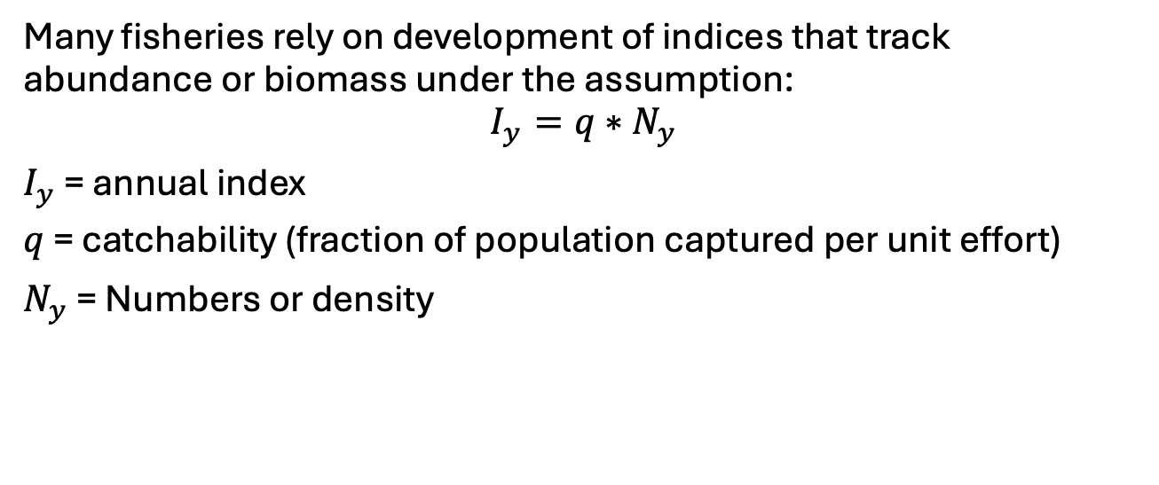
Index standardization
Many fisheries rely on development of indices that track abundance or biomass under the assumption:
$$I_{y}=q∗N_{y}$$
$I_{y}$ = annual index
$q$ = catchability (fraction of population captured per unit effort)
$N_{y}$ = Numbers or density

Slide 3
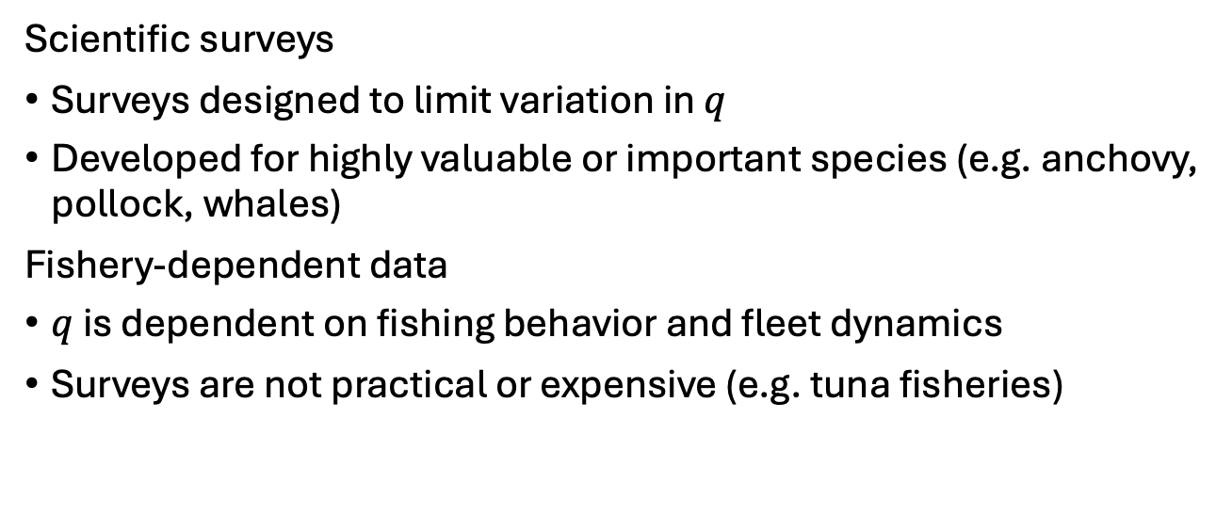
Sources of data
Scientific surveys
Surveys designed to limit variation in $q$
Developed for highly valuable or important species (e.g. anchovy, pollock, whales)
Fishery-dependent data
$q$ is dependent on fishing behavior and fleet dynamics
Surveys are not practical or expensive (e.g. tuna fisheries)

Slide 4
Common index models
Generalized Linear Models (GLMs)
Generalized Linear Mixed Models (GLMMs)
Generalized Additive Models (GAMs)
Generalized Additive Mixed Models (GAMMs)
Model choice is often dependent on data-available and analyst

Slide 5
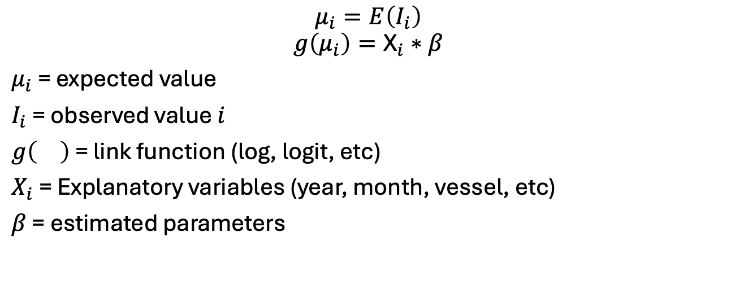
Fundamentals
$$μ_{i}=E\left(I_{i}\right)$$
$$g\left(μ_{i}\right)={\text{X}}_{i}∗β$$
$μ_{i}$ = expected value
$I_{i}$ = observed value $i$
$g\left(\right)$ = link function (log, logit, etc)
$X_{i}$ = Explanatory variables (year, month, vessel, etc)
$β$ = estimated parameters

Slide 6
Common distributions
Presence/absence:
Binomial (logit link function)
Numbers:
Poisson (log link function)
Negative binomial (log link function)
Biomass:
Normal
Gamma
Many more!!

Slide 7
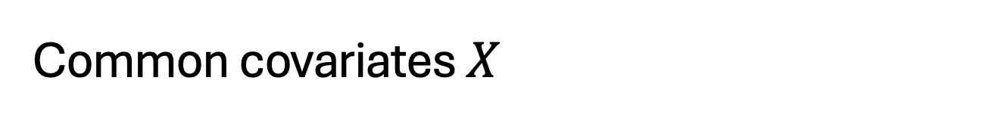
Common covariates $X$
Year or time
Factors that influence catchability:
Vessel (some vessels may be more efficient/bigger nets)
Time of day (fish move up and down the water column)
Temperature (fish migrate into the survey area seasonally with temperature)

Slide 8
Implementation (1)
Multiple R packages
GLM: stats
GLMM: glmmTMB, lme4, nlme
GAM: mgcv
GAMM: mgcv, gamm4

Slide 9
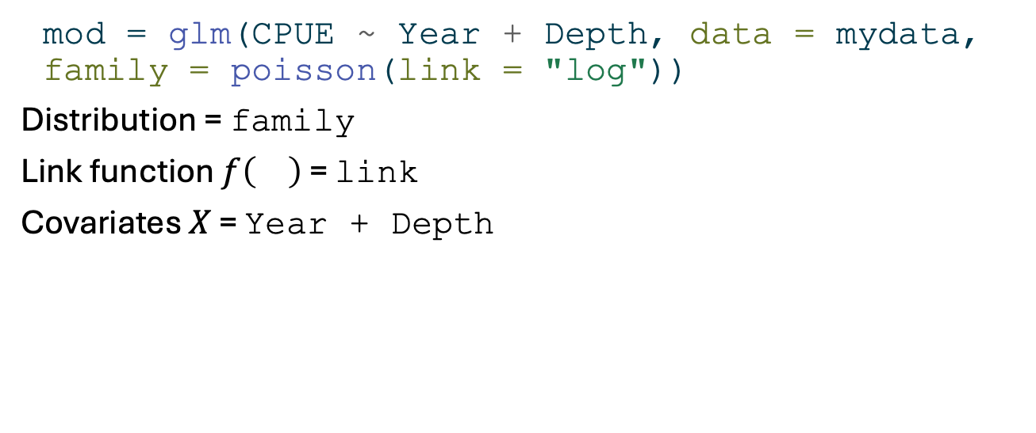
GLM implementation (2)
mod = glm(CPUE ~ Year + Depth, data = mydata, family = poisson(link = "log"))
Distribution = family
Link function $f\left(\right)$ = link
Covariates $X$ = Year + Depth

Slide 10
Diagnostics
Standard regression diagnostics should be used such plot(mod)
Residuals vs fitted values (model misspecification)
Sqrt of abs of residuals vs expected values (variance correctly specified)
QQplot (residuals normally distributed)
Observed vs predicted

Slide 11
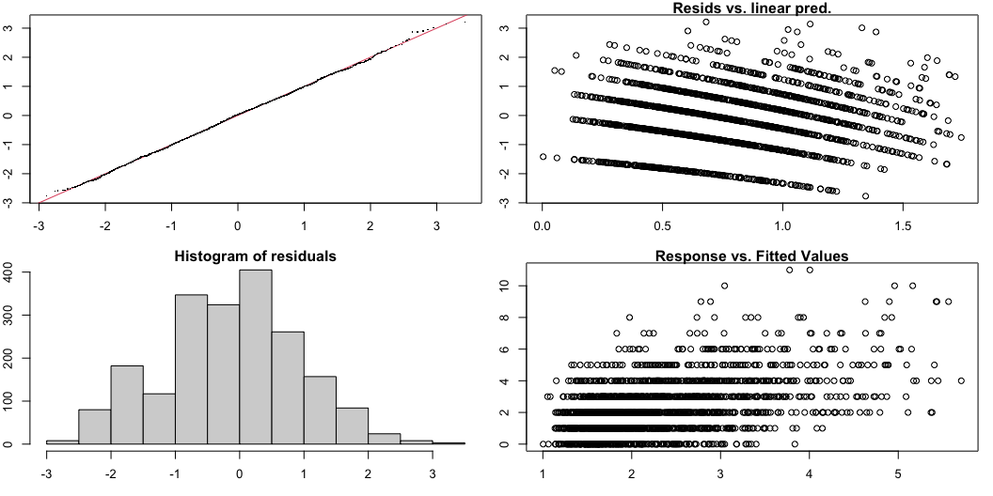
Good model diagnostics

Slide 12
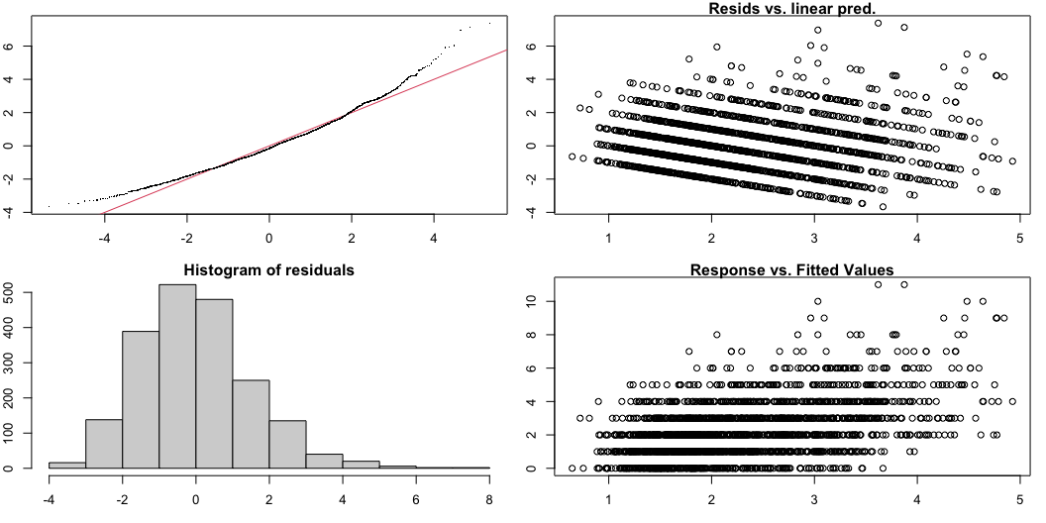
Wrong distribution

Slide 13
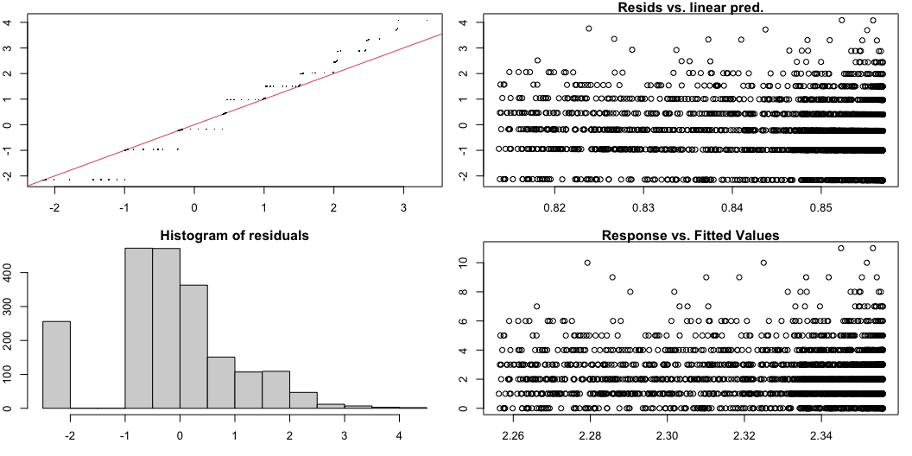
Missing predictors

Slide 14
Model selection
Information Criterion: AIC, BIC, WAIC
Measure of model fit, penalized for the number of parameters
Predictive skill: k-fold cross validation

Slide 15
Model selection
K-fold cross validation code

